Slide 1

CNN Part A
WE START WITH CLEANING THE DATA...

Slide 2
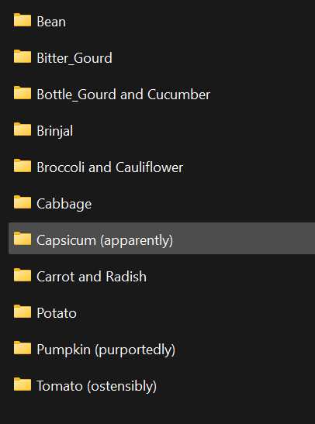
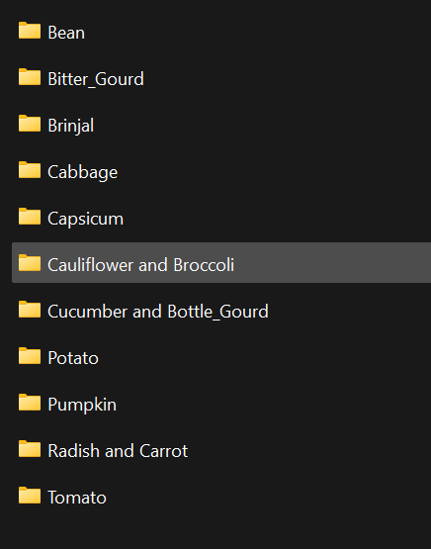
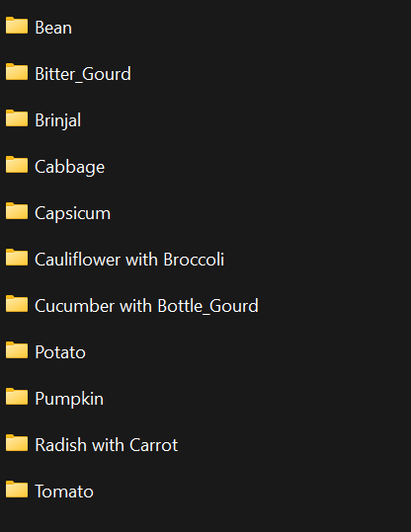
FILE DIRECTORY IN DATASET
TEST
TRAIN
VALIDATION
Problem after analysis:
As we can see, some file names that contain images of the vegetables are not kept consistent across the dataset.
Fix:
Changed the name of the files that are not consistent across all three files.

Slide 3
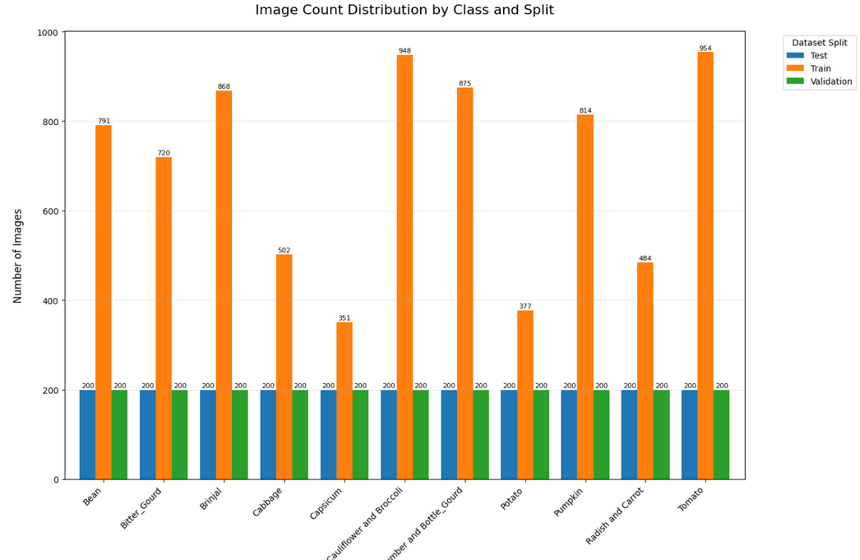
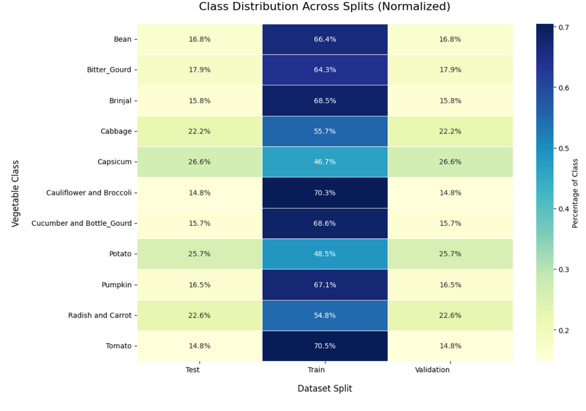
Exploratory Data Analysis
Observation:
From initial dataset visualisation, from the bar graph and the heatmap our data is split unevenly.
Problem after analysis:
Some files are using different image formats
Different files have varying no. of images
Some images are duplicates
Fix:
Do data augmentation, include all image formats (eg. png, jpg, jpeg), remove duplicates.

Slide 4
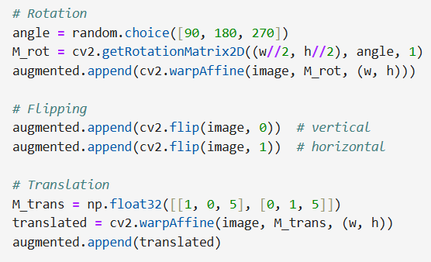
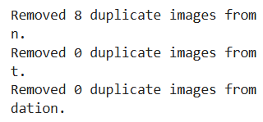
Data Cleaning and preprocessing
Used image hashing to remove duplicate images
We can start by increasing the amount of training data for each class until they all have 954 images by using data augmentation.
- Rotating
- Transformation
- Flipping

Slide 5
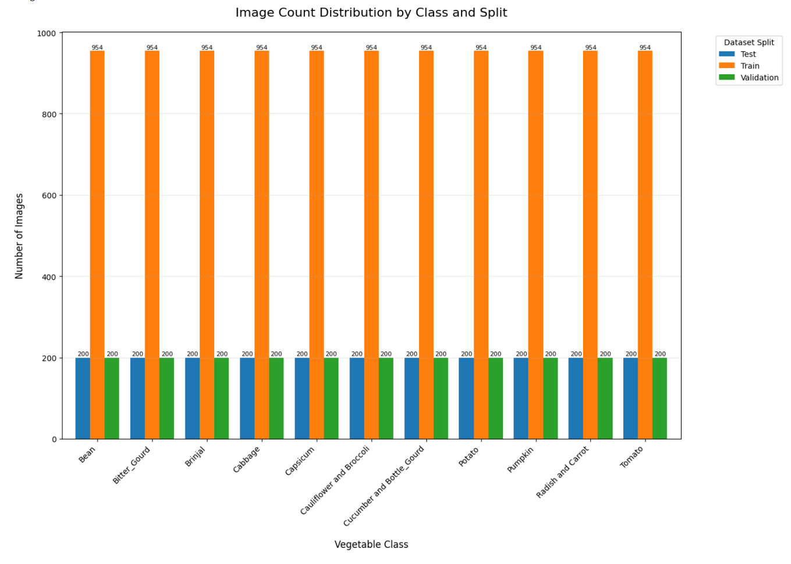
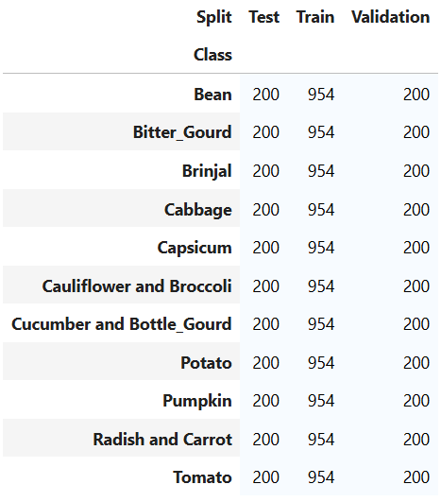
Data Cleaning and preprocessing
Now that we have our dataset ready and balanced we can start importing them to be grayscaled and resized according to project requirements.

Slide 6
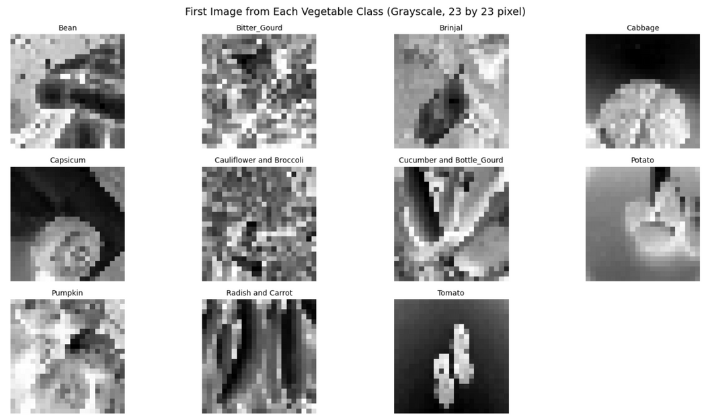
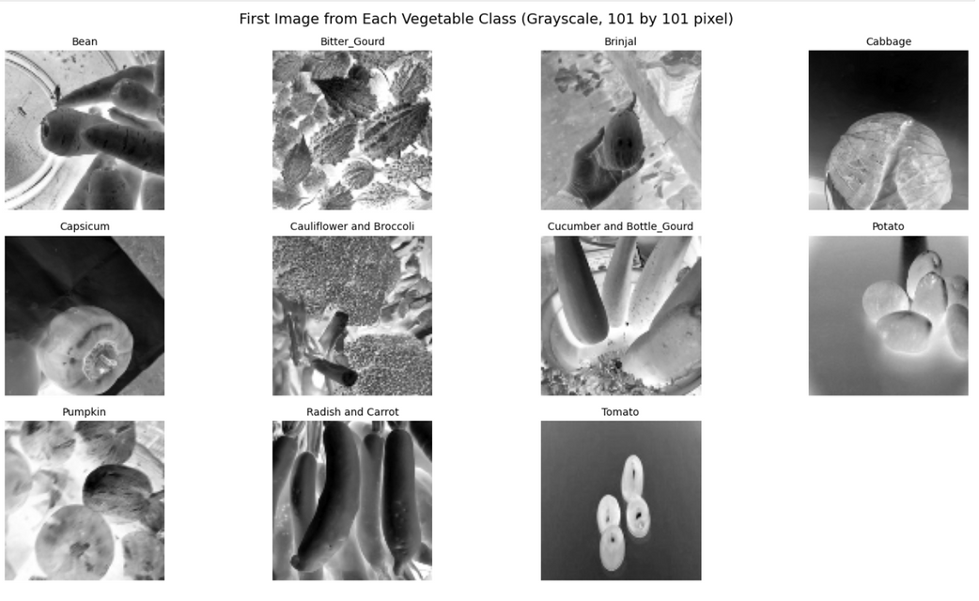
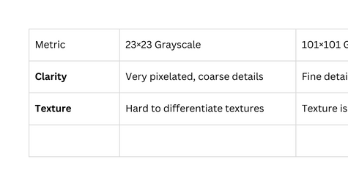
Data preprocessing
23 by 23, grayscaled
101 by 101, grayscaled
Useful insights:
Generalization vs. Overfitting Risk
23×23 has less information, reducing the chance of overfitting, but might underfit (not enough signal).
101×101 has richer features, but may risk overfitting on small training sets unless regularization (dropout, L2) and augmentation are used.

Slide 7
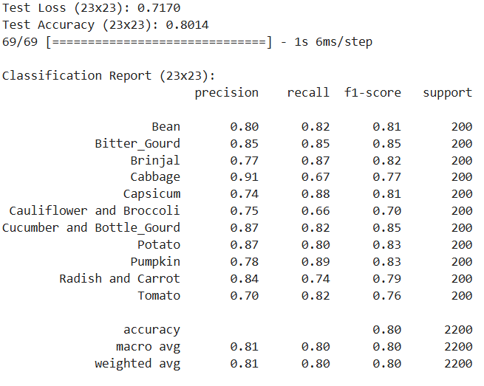
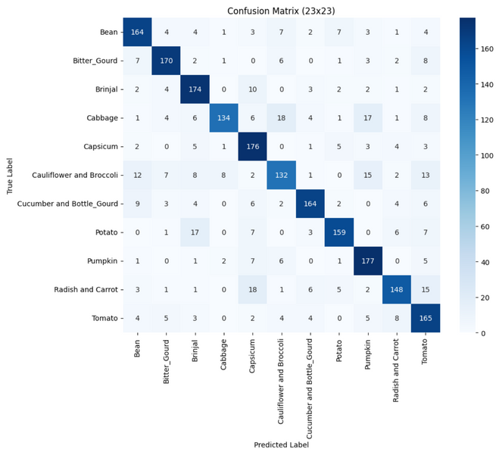
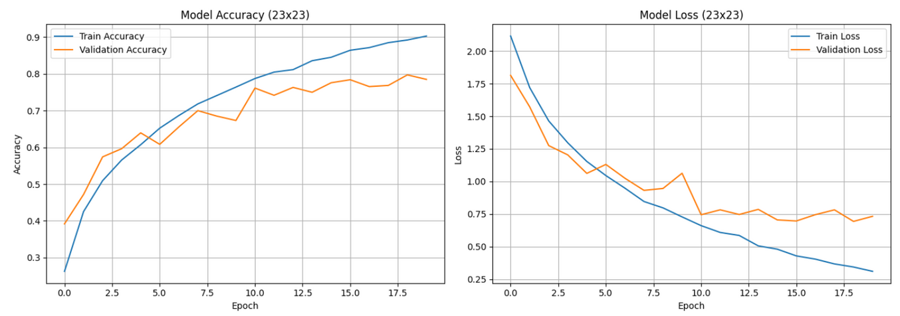
Base model for 23 by 23 (grayscaled)
Inference and Next Steps
Overfitting → train vs validation gap
Limited input resolution (23×23) may have hindered feature extraction.
What to Consider for Hypertuning:
Increase Model Complexity: Add more layers or filters.
Add more Dropout or BatchNormalization to reduce overfitting.

Slide 8
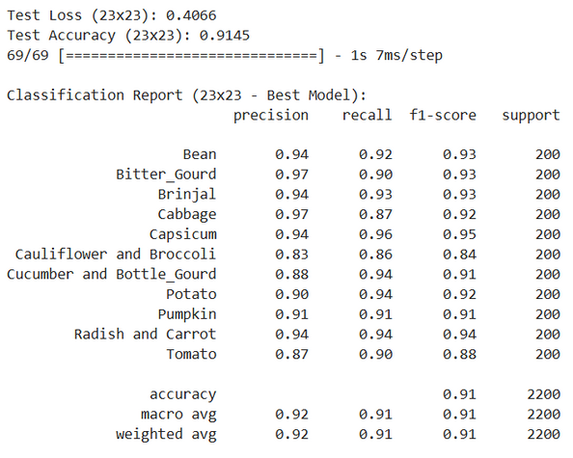
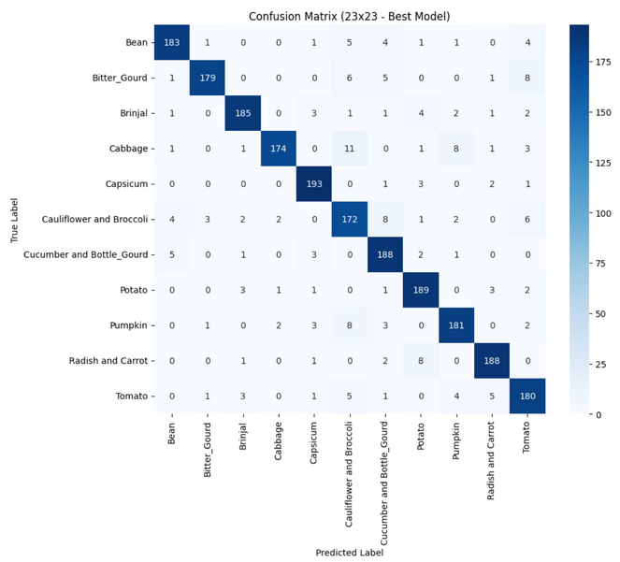
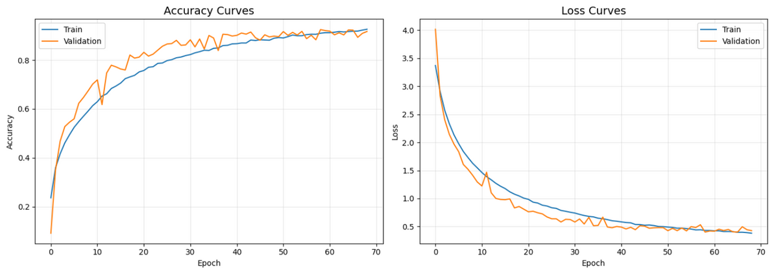
Best model for 23 by 23 (grayscaled + hypertuned)
Performance Gains:
Test Accuracy improved from 80.1% ➝ 91.45%
Test Loss reduced from 0.717 ➝ 0.408
Accuracy Curve:
Both train and val accuracy steadily improve and plateau around 91–92%.
No overfitting: the validation accuracy is close to training accuracy.
Loss Curve:
Loss reduces sharply at first, then converges nicely — indicating stable learning.
Validation loss closely follows training loss (good generalization).

Slide 9
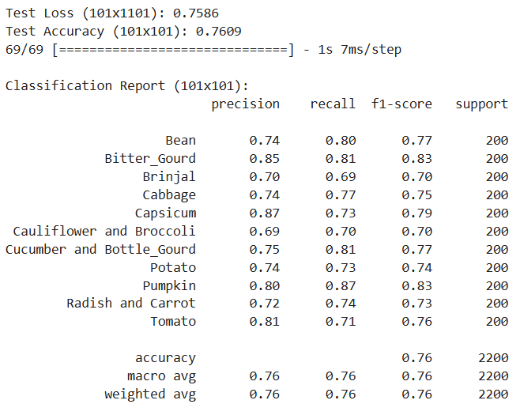
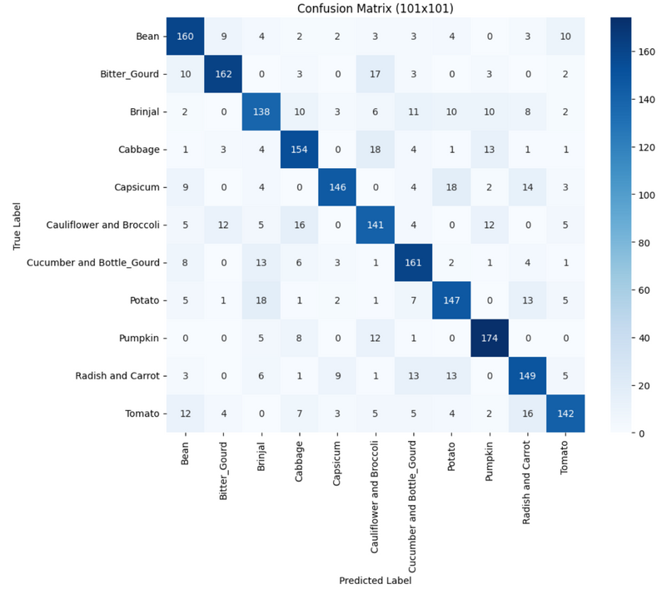
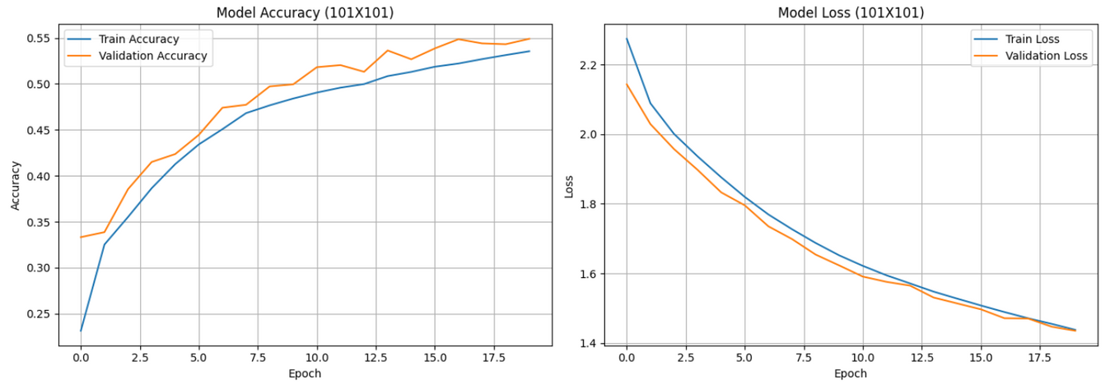
Base model for 101 by 101 (grayscaled)
Why performance didn't improve from 23×23 base model?
Model depth unchanged → same shallow architecture as 23×23, now overwhelmed by more data.
Lack of regularization → no Dropout, BatchNorm, or L2 to stabilize deeper learning.
Flatten layer limitation → leads to large parameter count and weak generalization on large inputs.
Training plateaus early → more training time or dynamic learning rate might be required.
What we need to strengthen our model:
Deeper (more conv layers)
More regularized (dropout, L2, batchnorm)
More structured (like GlobalAveragePooling instead of Flatten)
Better optimized (lower LR, early stopping, LR scheduling)

Slide 10
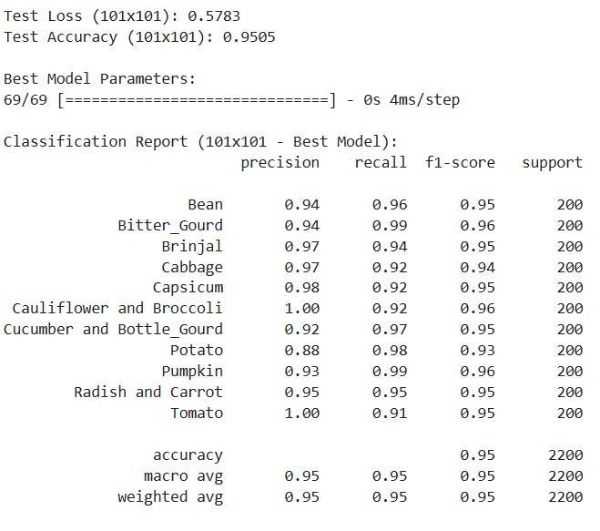
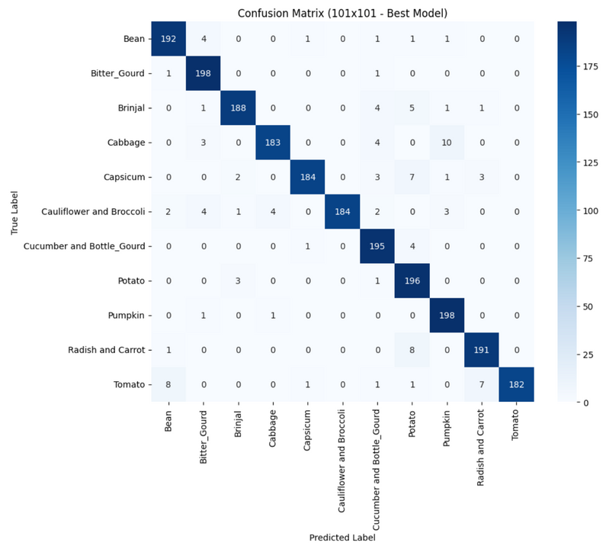
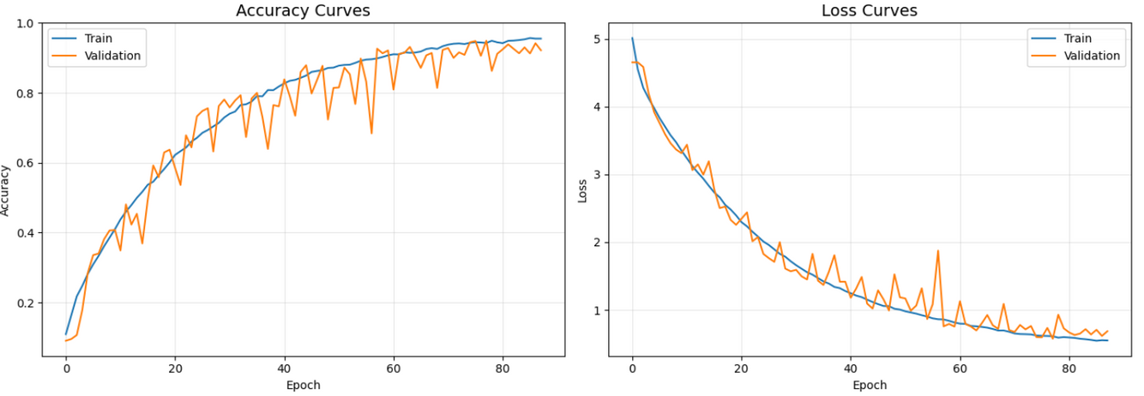
Best model for 101 by 101 (grayscaled + hypertuned)
Accuracy Curve:
Smooth and consistent climb to 95% accuracy, no severe overfitting.
Validation closely follows training — very good generalization.
Loss Curve:
Both losses drop and converge steadily.
Minor validation spikes (common), but overall shows stable training.

Slide 11
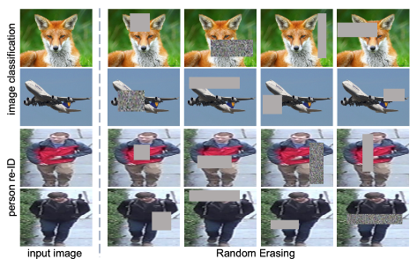
FURTHER DATA AUGMENTATION
When thinking of which of the many data augmentations to use, I decided on random erasing because i wanted to try something unique instead of using class weights or any others.
In training, Random Erasing randomly selects a rectangle region in an image and erases its pixels with random values. In this process, training images with various levels of occlusion are generated, which reduces the risk of over-fitting and makes the model robust to occlusion.

Slide 12
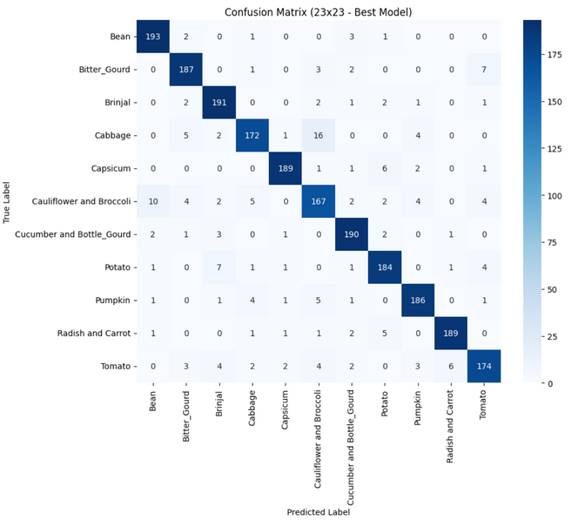
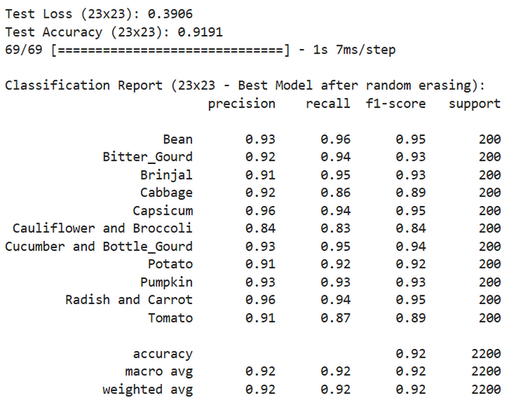
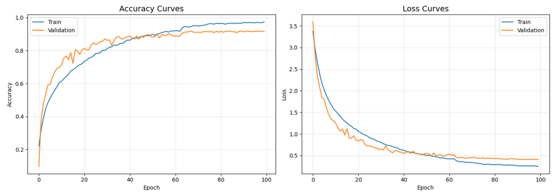
FURTHER DATA AUGMENTATION
Observation after retraining with random erasing
for 23 by 23:
After using the function random erasing on the train dataset, we can see that it has the performance has slightly improved
We can assume that the model potentially overfitting to specific aspects of the training data
We have solved the issue that our model was not robust enough to handle variations or occlusions

Slide 13
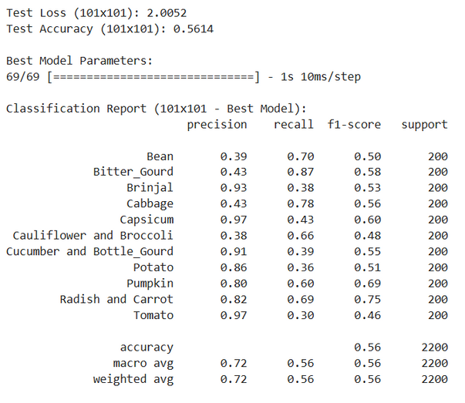
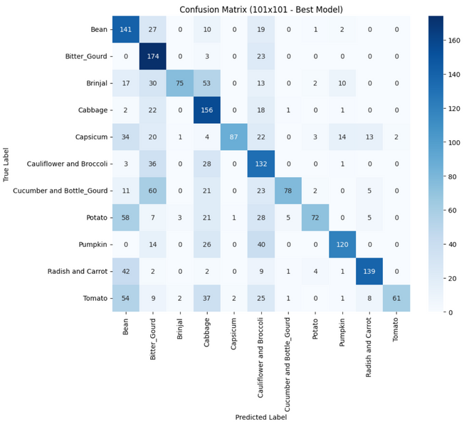
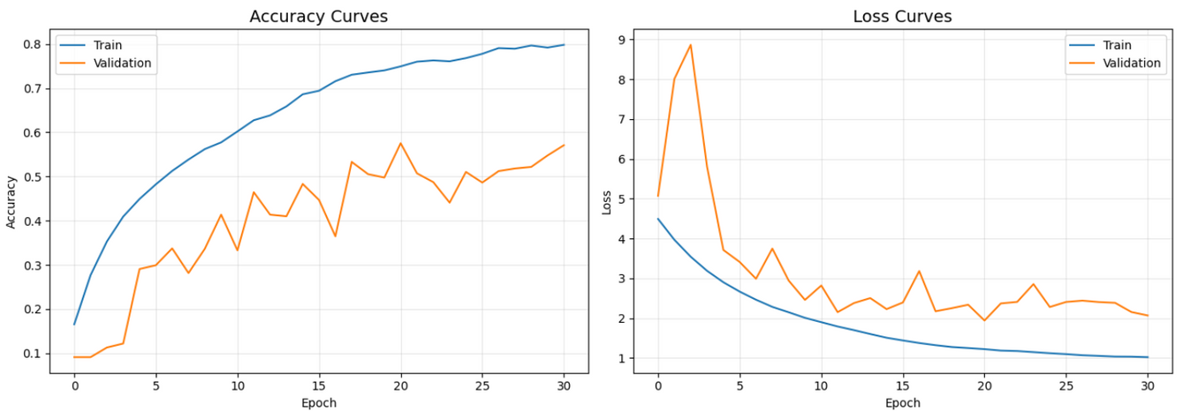
FURTHER DATA AUGMENTATION
Observations after retraining with random erasing for 101 by 101:
Our model's performance significantly decreased after applying random erasing
This might indicate that the data augmentation technique is not suitable for the specific model or the dataset. As evident from the horrendous performance
This could have been caused by our model's complexity, due to how many layers we have, we could have amplified its weakness and decreased our 101 by 101 model's performance significantly

Slide 14
The End
THANK YOU FOR LISTENING, NOW ON TO PART B :)

